Slide 1
College Council
October 7, 2021

Slide 2
Reporting Committees

Slide 3
Facilities – Cody Pauxtis

Slide 4
Safety & Security – Kevin King
CFIT Proposal and Team recommendation Approved
To determine the current Safety and Security needs of all Cerro Coso Campuses and to develop a proposal for how to meet those needs.
Admin- Kevin King, Chad Houck, Lisa Stephens, Deanna Campbell, Katie Bachman
Faculty- Justus Scott, Tyson Huffman, Melissa Bowen
Classified - Kevin Lefler, Sarah Land, Inge Olson.
Student- Amanda Barry
Great ShakeOut Exercise October 21, 2020
All campuses Participating
Testing the Mitel phone emergency messaging system.
Discussed future National Safety Campaign event ideas.
Next meeting: October 19

Slide 5
Technology Resource Team (TRT) – Mike Campbell
Next meeting October 13, 2021
Reviewing the IT AUP draft

Slide 6
Student Success Support Programs (SSSP) – Heather Ostash
Refresh on Guided Pathways
-Focus 20-21 on the 3rd and 4th goals of GP
-Case management approach to keeping students on path
-Strategies for ensuring learning
-Potential C-FITS in these areas
-Continued focus on communication and Pathway/Career connection
-Revisit meta-major discussion

Slide 7
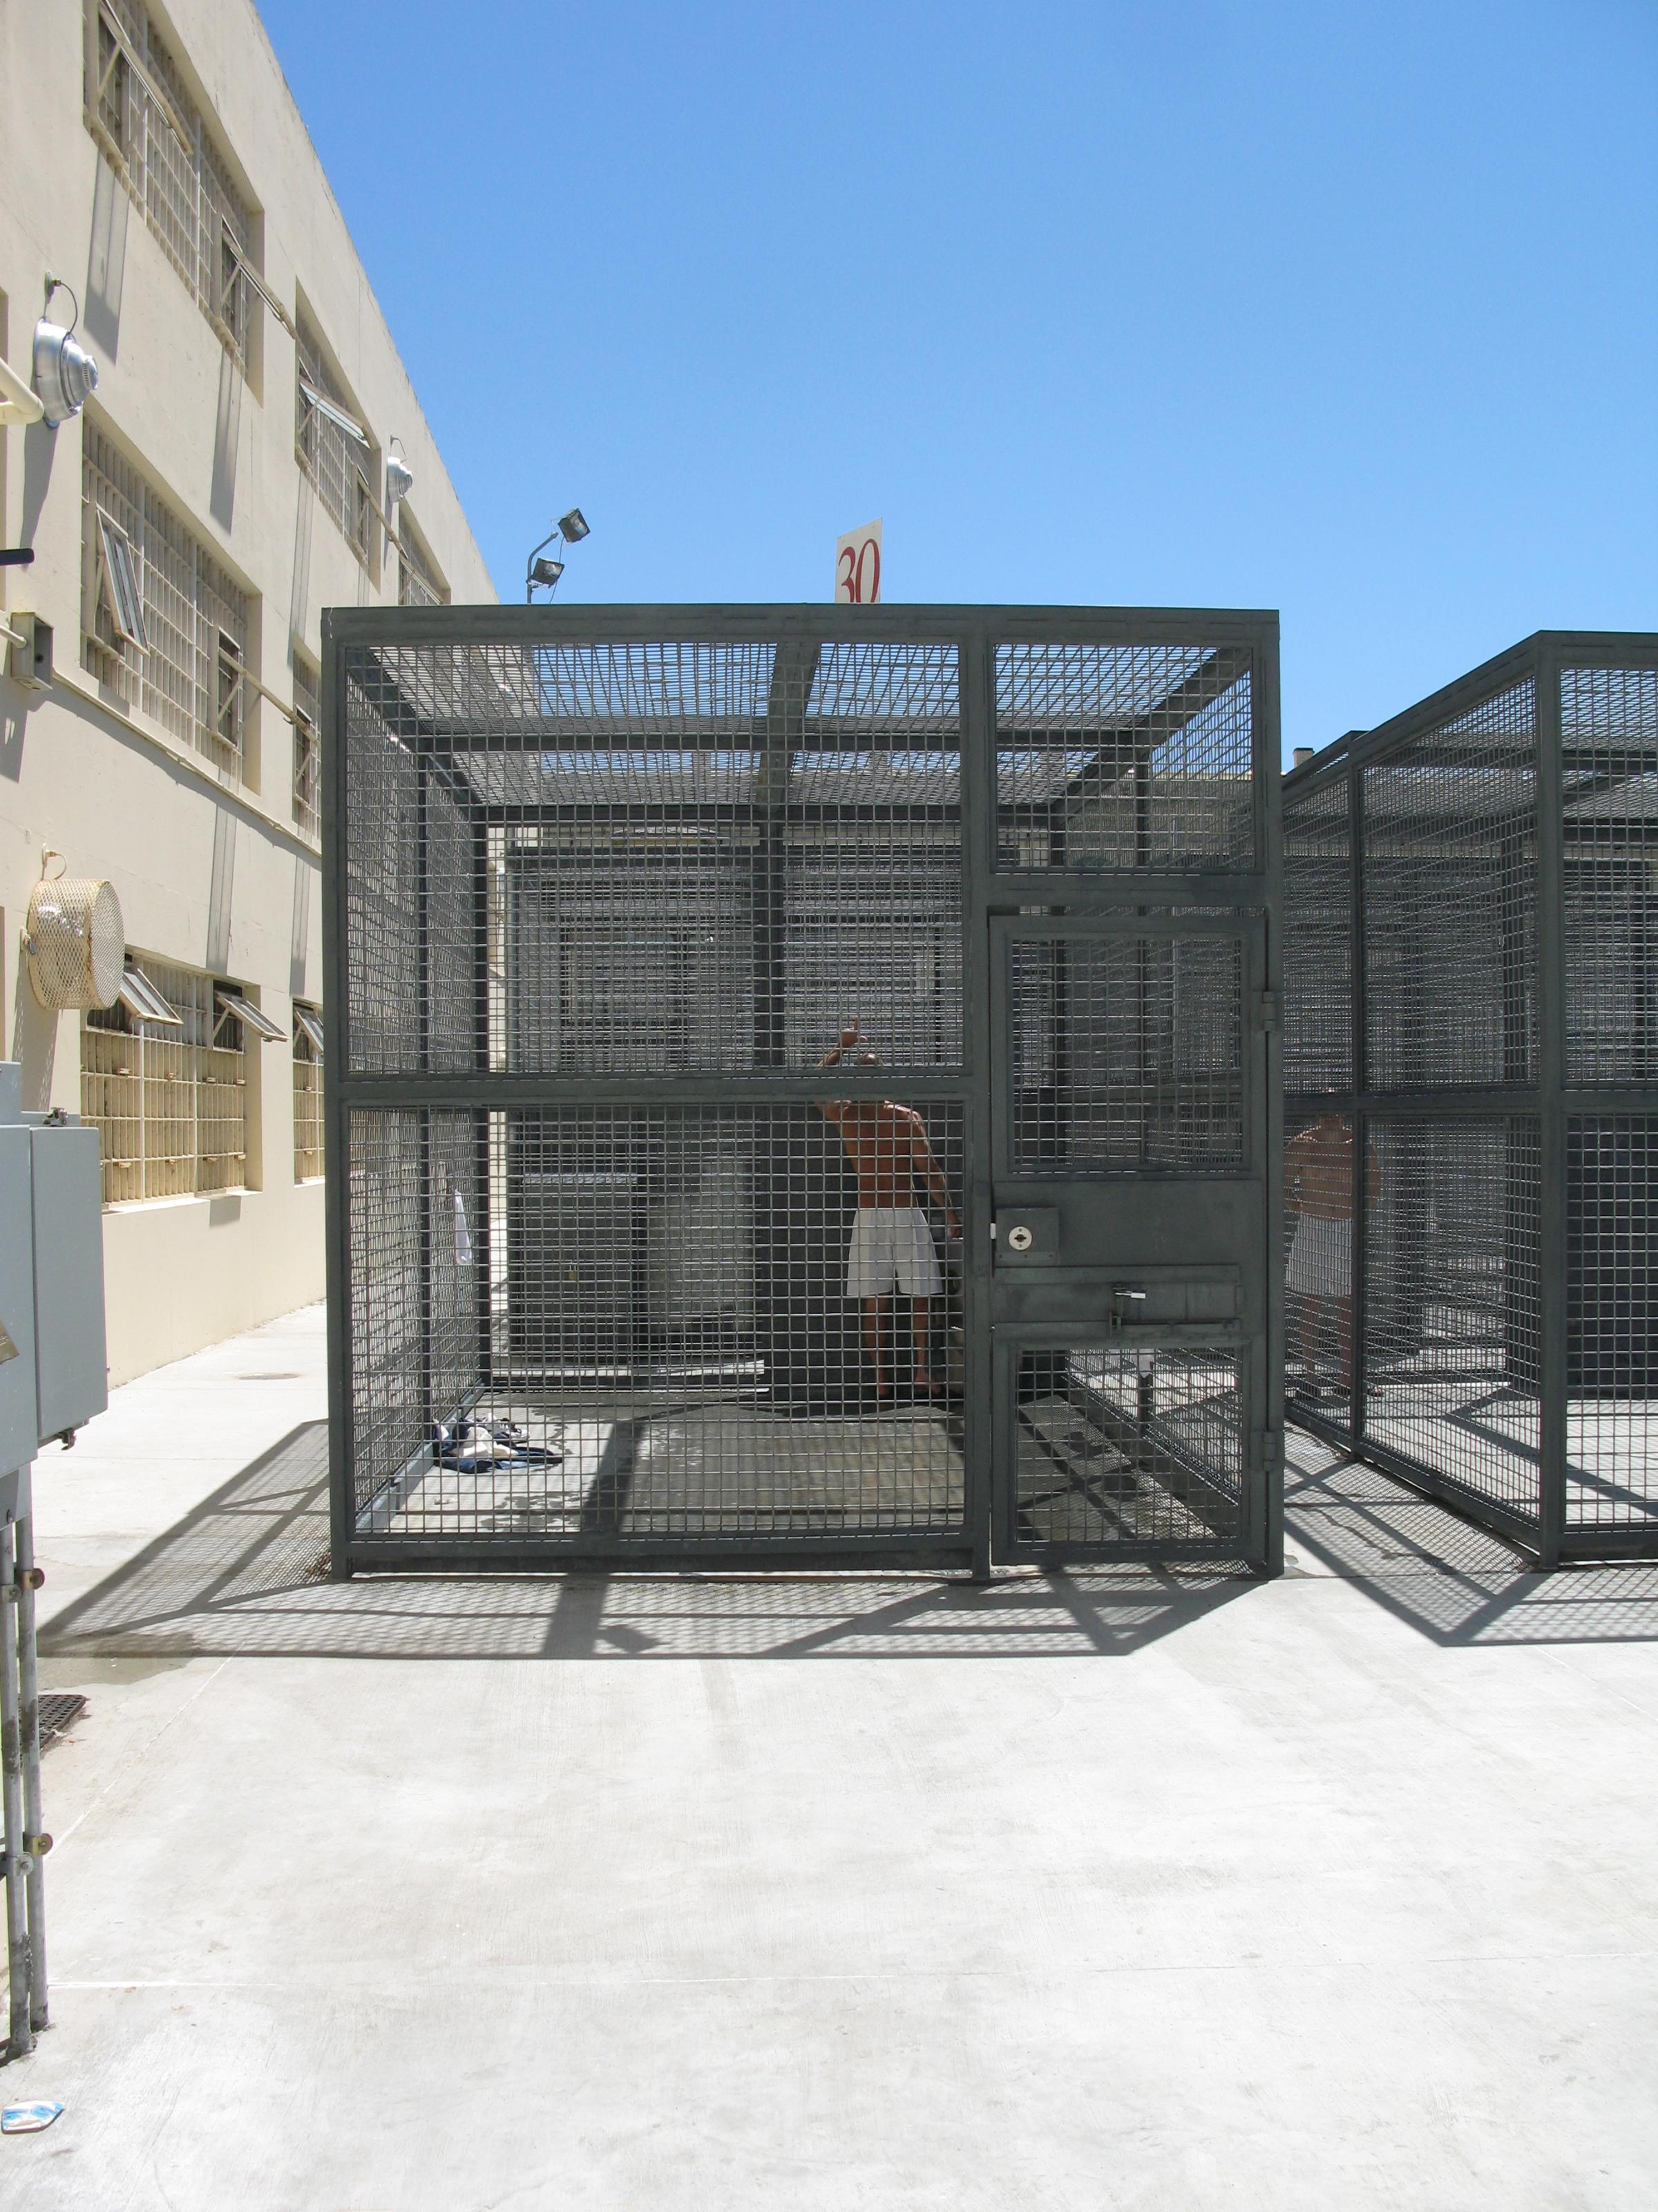
Incarcerated Students Education Program – Peter Fulks
First meeting on 9/28
New student rep Nicole Harper
Hybrid courses are a preferred by students
Laptop program possibility at CCI
Library is amazing in D yard and has been giving given Kudos from the state level
Request for a faculty training summit to develop Canvas courses

Slide 8
Constituency Reports

Slide 9
Associated Committees

Slide 10
Budget Development – Lisa Couch
Next meeting is October 12, 2021
Budget Rubric posted on the planning website
Resorted to excel worksheets for budget requests for unit plan preparers – hope to have system issues resolved for section plans.
Continuing to review HEERF (COVID) funding requests regularly

Slide 11
District Wide Budget Development Committee – Lisa Couch
Next meeting is October 8, 2021

Slide 12
Institutional Effectiveness Committee (IEC) – Corey Marvin
IEC met on Thursday, September 23
Updates
AUP Planning App now in Canvas,
Budget software not ready for AUP's, shooting for ASP's
Budget rubric in effect this year
Reached end of rope on eLumen
Accreditation midterm report and process
Vision Resource Center free integration ends December
2020-21 focus on improving college-wide dialogue
Next meeting, Thursday, November 18

Slide 13
Professional Development Committee – Corey Marvin
Has not met. Next meeting Wednesday, October 20

Slide 14
Accreditation – Corey Marvin
Has not met though AS Exec Council consulted about faculty role in midterm report

Slide 15
The End

